Slide 1
Secure data hiding in image using steganography
CAPSTONE PROJECT
Presented by
Student Name : P Stella Mercy
College Name & Department : Symbiosis Institute of Technology, EnTC

Slide 2
OUTLINE
Problem Statement
Technology used
Wow factor
End users
Result
Conclusion
Git-hub Link
Future scope

Slide 3
Problem Statement
Secure communication often requires hiding sensitive data in a way that prevents unauthorized access. Traditional encryption methods can make the presence of hidden data obvious, making them susceptible to detection.
So, this project utilizes steganography to encrypt and conceal data within an image. The image is protected with a password, ensuring that only the intended recipient, who possesses the correct password, can decrypt and access the hidden information. The embedded data can be of any type, including secret messages or even potentially harmful files, emphasizing the need for secure handling and transmission.

Slide 4
Technology used
This project was developed on a Windows 11 computer using Python as the core programming language. Below are the libraries I have used in this project :
cv2 (OpenCV): For image processing and manipulation.
NumPy: For efficient data handling and processing.
Tkinter: For building a user-friendly graphical interface.
ttk (from Tkinter): For advanced GUI styling and widgets.
filedialog (from Tkinter): For file selection and management.
messagebox (from Tkinter): For displaying alerts and messages to users.
TkinterDnD (from tkinterdnd2): For enabling drag-and-drop functionality.
os: For interacting with the operating system, such as file handling.
time: For adding delays and managing time-based functions.
I have integrated these technologies so that the project ensures smooth and secure encryption and decryption of hidden data while providing a user-friendly experience.

Slide 5
Wow factors
Here’s how I made my project unique :
To make it a user-friendly experience, I have created a GUI using python.
Special features in the GUI include –
Drag and Drop feature: no need to browse manually for your image, just easy drag and drop.
Encryption and Decryption: buttons for all the necessary actions, so it’s just one click away.
Clear button: to reset the program easily instead of restarting the program all over again.
Progress bar: to show real-time processing time of the encryption and decryption.
Message box alerts: message pop-ups for confirmation, errors and warnings so trouble-shooting is made easier.
File handling: this GUI also supports file dialog browsing for anyone who doesn’t want to use drag and drop.
This program takes the least amount of space and runs on any system and integrates OpenCv and NumPy for efficient handling of image and data.
Data type: supports all kinds of files(.png, .jpg, .jpeg) and can hide all kinds too (text, files, images, even malware for testing purposes).

Slide 6
End users
Steganography is used for both good as well as bad purposes. Legitimate users can be –
the Military and Government officials
Cyber security Professionals
Journalists/Whistle Blowers
Intelligence agencies(CIA/NSA/RAW/IB/DIA)
Corporate companies for trademarking and copyright protection.
Malicious users can be –
Hackers and cyber criminals
Terrorists
Dark-web users for trading illegal stuff

Slide 7
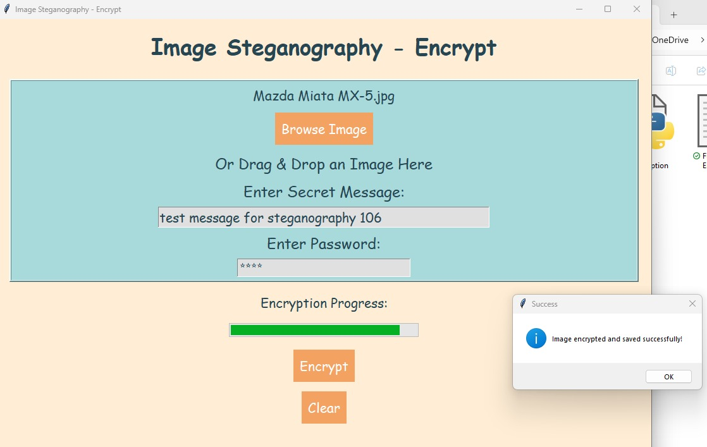
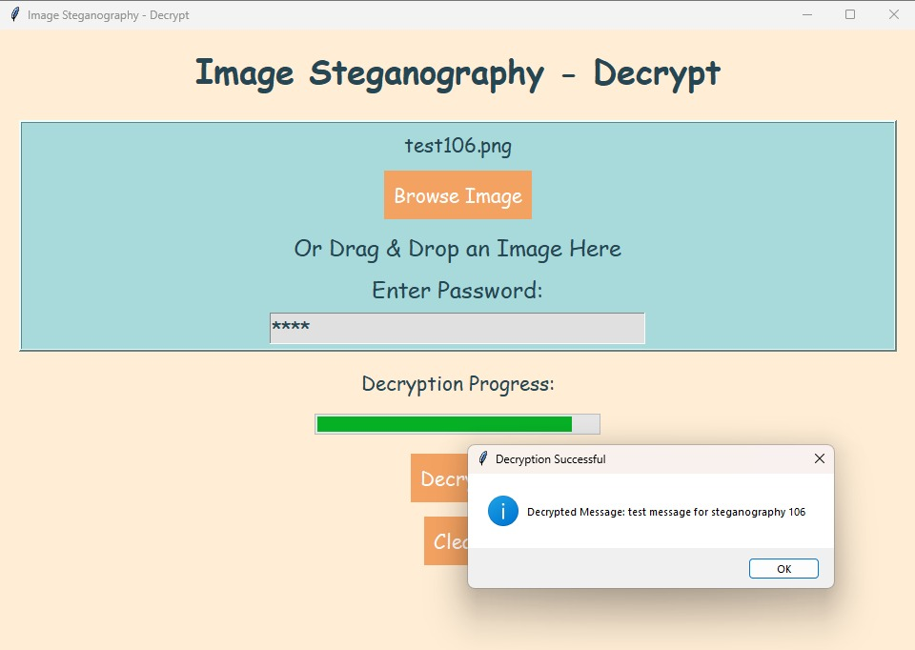
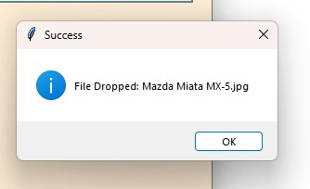
Results

Slide 8
Conclusion
Steganography is a powerful and efficient way to hide data within images, ensuring security while keeping the information discreet. This project simplifies the process with password protection, an intuitive GUI, and drag-and-drop functionality, making encryption both seamless and effective. While steganography has valuable applications in cybersecurity and privacy, it also highlights the risks associated with hidden data.
Overall, this project demonstrates how steganography can be used responsibly and efficiently, combining security with ease of use.

Slide 9
GitHub Link
Here’s my GitHub link :
https://github.com/stellamercy/Stegolock.git

Slide 10
Future scope
This project has great potential for further improvements, including:
Support for More File Types: Expanding to hide audio, video, and documents inside images.
Stronger Security: Adding multi-layer encryption and making hidden data even harder to detect.
Cross-Platform Compatibility: Optimizing for Linux, macOS, and mobile devices.
Cloud Integration: Allowing secure upload and sharing of encrypted images.
Stealth Mode: Making encryption less detectable for extra privacy.
These enhancements can make the project more advanced, secure, and accessible in the future.

Slide 11
THANK YOU

